Slide 1

WHY TO INVEST IN THE CZECH REPUBLIC?

Slide 2
OVERALL CHARACTERISTICS
The Czech Republic is located at the geographical heart of Europe and borders with Germany and Austria in the west, and Poland and Slovakia in the east. The republic has an area of 78,864 square kilometres (approximately 30,500 square miles) and consists of three distinct regions: Bohemia in the west, and Moravia and part of Silesia in the east. According to the latest statistics, the population of the Czech Republic is 10.5 million (as of 1 January 2012).
Prague, the capital, is the largest city, with a population of 1,241,664.
Other major urban centres include:
• Brno (378,965)
• Ostrava (299,622)
• Plzeň (167,302)
• Liberec (102,005)
• Olomouc (99,529)
• Ústí nad Labem (94,258)
• České Budějovice (93,620)
• Hradec Králové (93,490)
• Pardubice (89,552)

Slide 3
ECONOMY
GDP per capita | $ 26,426
GDP real growth rate | - 1,6 % ( Q3 2013)
Labour force | Cca 5.2 milion
Unemployment | 7,6 % (November 2013)
Currency (code) | Czech Crown (CZK)
CZK/EUR average (november 2013) | 27,1 CZK (November 2013)
Czech statistical authority, 2013

Slide 4
BRANCH STRUCTURE OF INDUSTRY
www.czechinvest.org, 2013

Slide 5
MAIN EXPORT PARTNERS
http://atlas.media.mit.edu/country/cze. 2013

Slide 6
MAIN IMPORT PARTNERS
http://atlas.media.mit.edu/country/cze, 2013

Slide 7
MAJOR EXPORTS |  | MAJOR IMPORTS
Cars | 10% | Automatic data processing machines | 5%
Pats and accesories of the motor vehicles | 7% | Parts and accessories of the motor vehicles | 5%
Automatic data processing machines | 6% | Parts and accessories for office machines | 3%
Monitors and projectors | 2% | Diodes, transistor, semiconductor devices, photovoltaic cells | 3%
Insulated wire, optical fiber cables | 2% | Medicaments, packaged | 3%
http://atlas.media.mit.edu/country/cze, 2013

Slide 8
TOP 10 FOREIGN INVESTMENTS
Hyundai | Korea | USD 1.2 bilion
Toyota/PSA | Japan/France | USD 850 milion
Volkswagen | Germany | USD 710 milion
Robert Bosch | Germany | USD 361 milion
Matsushita | Japan | USD 335 milion
Nemak | Mexico | USD 317 milion
Denso | Japan | USD 254 milion
Dalkin | Japan | USD 244 milion
Panasonic | Japan | USD 235 milion
LG Philips | NL | USD 201 milion
http://www.state.gov/e/eb/rls/othr/ics/2011/157266.htm, 2013

Slide 9
FOREIGN DIRECT INVESTMENT (FDI)
According to the 2012–2013 Global Competitiveness Report published by the World Economic Forum in its Global Competitiveness Report 2011–2012, the Czech Republic ranks 39th among 144 world economies in terms of competitiveness.
www.reports.webforum.org/global-competitiveness-report-2012-2013, 2013
CzechInvest, the investment and business development agency of the Czech Republic, states that the Czech Republic is one of the most successful Central and Eastern European (CEE) countries in terms of attracting FDI. The introduction of investment incentives in 1998 stimulated a great inflow of FDI into greenfield projects. The accession to the EU in 2004 and the 2012 amendments to the investment-incentives legislation have further boosted investment. According to the Economist Intelligence Unit, the Czech Republic has a status of highly attractive destination for foreign investors
www.czechinvest.org/en/why-invest-in-the-czech-republic, 2013

Slide 10
KEY FACTOR ATTRACTING FOREIGN INVESTOR
strategic location
high-quality infrastructure
relatively low labour costs
availability of a skilled workforce
favourable business climate
stable political environment

Slide 11
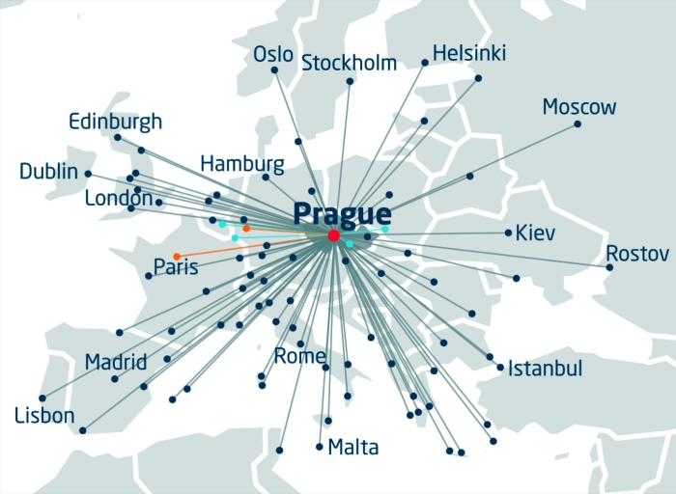
STRATEGIC LOCATION
One of the advantages of the Czech Republic is its ideal geographical location in the centre of Europe and its cultural proximity to Western Europe. This area is considered the best choice for investments in transport and logistics and a perfect gateway to the single European market of 502 million consumers.
www.prg.aero

Slide 12
LABOUR COSTS IN COMBINATION WITH SKILLED WORKFORCE
Although the country’s labour costs are higher than in some Asian countries, they still remain below the level of the labour costs in Western Europe. This in combination with skilled labour makes an important argument for deciding to place new investment in the Czech Republic.
The Czech Republic has rising level of education standards among its population. About one-third of Czech students study economics, finance or IT. The tradition of the technical education in the Czech Republic is long and enjoys a strong reputation around the world.
According to the OECD 92 % of the population in the 25–64 age range has completed at least upper secondary education, ranking the Czech Republic among the highest of all of the OECD countries, compared to the OECD average of 74 % and EU average of 75 % of the same age range. 17 % of the population have attained tertiary education.
The official language of the Czech Republic is Czech. The foreign languages most widely spoken are English and German. According to the Institute for Information on Education, 79 %of university students study one foreign language, 19 %study two and 1.7 %study three or more foreign languages.

Slide 13
Czech statistical authority, 2012

Slide 14
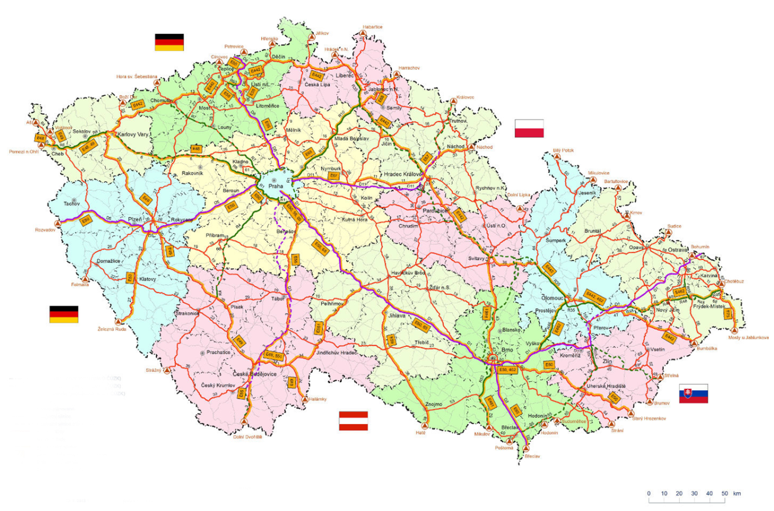
HIGH-QUALITY INFRASTRUCTURE
Wide transportation network and good internal rail and road network (with proposed further investments to infrastructure by the government) make the Czech Republic as a crossroads of major European transit corridors. In addition there is a great expansion of air traffic in the country. As part of the European Union, the Czech Republic offers to the prospective foreign investors an excellent position to serve the most populated markets from their bases here.
55,752 km of roads in operation
734 km of motorways
Density of 0,7km of roads and motorways/km²
Prague as the centre of the road network
http://www.mdcr.cz/cs/default.htm

Slide 15
FAVOURABLE BUSINESS CLIMATE
The Investment Incentives Act Amendment, which came into force on July 12, 2012, significantly improved the conditions for new investments, which are now more attractive to investors. Investment incentives are available now not only to investors launching or expanding production, but also to technological centres and strategic service centres.

Slide 16
NATIONAL INCENTIVES SCHEME
Tax incentives | Corporate income tax for up to 10 years for new companies
Job creation grants | Financial support for creation of new jobs
Training and retraining grants | Financial support for training and retraining new employees
Cash Grant on capital investment | Financial support in the case of strategic investments in manufacturing or in technology centres
Site support | Transfer of public land at a favourable price
www.czechinvest.org, 2013

Slide 17
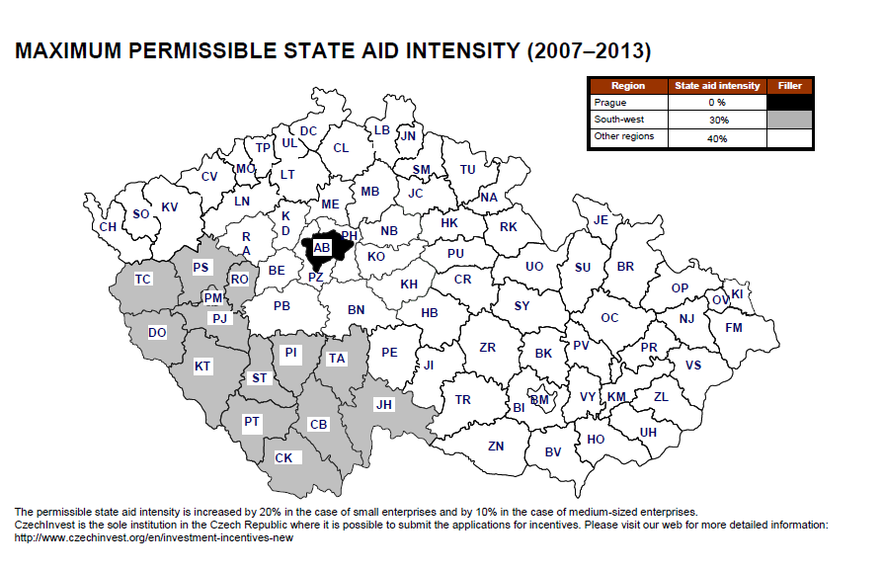
www.czechinvest.org, 2013

Slide 18

SUBSIDIES FROM EU FUNDS
Businesses set up in the Czech Republic are also able to obtain support from EU Structural Funds under several EU operational Programmes for projects mainly in the area of research and development (R&D), training centres, shared services centres and the environment
Subsidies granted under EU Structural Funds are generally subject to the same state aid rules and limits as investment incentives in the relevant country.
EU will enter the new budgetary period as of 1.1.2014 and the EU operational programmes will run from 2014 to 2020.

Slide 19
STABLE POLITICAL ENVIRONMENT
As of 1989, the Czech Republic enjoys the status of an advanced democracy and is a country based on the free-market economy.
The Czech Republic is a multi-party, parliamentary democracy. Legislative authority is vested in the parliament, consisting of a Chamber of Deputies (Poslanecka snemovna) and Senate (Senat). The president, elected every five years by parliament, is head of state, and appoints a prime minister from the majority party or coalition in the Chamber of Deputies. The risk of political violence in the Czech Republic is extremely low.
Czech foreign policy is pursued in an environment consisting of international organisations and institutions. The Czech Republic is a member of:
• the European Union (EU)
• the Council of Europe
• the North Atlantic Treaty Organisation (NATO)
• the Organisation for Economic Co-operation and Development (OECD)
• the United Nations
• the International Monetary Fund
• the International Labour Organisation
• the World Trade Organisation
• and others.

Slide 20
OTHER SUPPORTING INVESTMENT FACTORS
Schengen area
Costs of living
Residential Accommodation and Office space
Transport
Attractive Living Environment (Medical Care, Leisure activities)

Slide 21
BRANCH OR SUBSIDIARY
The first consideration for new investors in the Czech Republic will be to establish the most appropriate vehicle through which to operate.
Czech law provides that persons and entities carrying on „systematic business activity“ in the territory of the Czech Republic must be licensed in the Czech Republic for such business.
A foreign investor is therefore required to obtain an appropriate trade licence and must apply for the entry of a branch or a subsidiary in the Czech Commercial Register.

Slide 22
SETTING UP A CZECH ENTITY
Business entity | Capital contributions | Liability of owners | Management
Joint-stock company | The minimum share capital of CZK 2 milion / 20 milion in the case of a public offering | No personal liablity (liability limited to shareholder contributions) | Board of directors, shareholders have no power to participate in management
Limited liability company | The minimum registred capital of CZK 200,000 (from 1/1/2014 the minimum registred capital will be set to CZK 1) | Unlimited personal liability for the obligations ONLY up to the amount of total unpaid contributions | The executive/s appointed by general meeting
General partnership | partners contribute money or services to the partnership; they share profits and losses | unlimited personal liability of the general partners for the obligations of the business | the partners have equal management rights, unless they agree otherwise
limited partneship | unlimited and limited partners contribute money or services to the partnership; they share profits and losses | unlimited personal liability of the unlimited partners for the obligations of the business; limited partners generally have no personal liability | only unlimited partners are permitted to manage the business
co-operatives | the minimum registred capital of CZK 50,000 | no personal liability | the executive/s appointed by general meeting

Slide 23
INVESTMENT BRIEFS
The Czech Government has approved the new research program Delta that will be the first to support international cooperation of Czech R&D organizations with their foreign partners. The program will receive CZK 0.75 bln (39.5 million USD) from the state budget.
Czech Energy and Industry Holding is about to buy German brown-coal district Helmstedt containing a coal plant Buschhaus from an energy group E.ON. The contract is just about to be made. E.ON has neither confirmed nor disproved this information. The purchase price is not yet known.
Smith Medial Czech Republic ceremoniously began operation of its new plant at CTPark in Hranice, in the Prerov region. The plant will produce single-use medical devices to support breathing and drug delivery. The company will employ up to 300 people there upon full completion of the project within roughly one year.

Slide 24
American Amazon intends to build two logistic and distribution centres of ten hectars close to Prague and Brno and it will cost approximately CZK 1 bln (52.7million USD). Construction is planned to be completed in the middle of year 2014. The complex will probably employ 1,000 people.
Continental Barum plans to invest almost CZK 2.5 bln (133.3million USD) into expanded truck tire production. The plant in Ostrokovice, Zlin District, will offer more than 290 new jobs. This is the largest investment mediated by CzechInvest in the first six months of 2013.

Slide 25
BUSINESS AND TRADE WEBSITES
General information about the Czech Republic:
www.czech.cz
Trade promotion agency CzechTrade:
www.czechtradeoffices.com
Investment and business development agency CzechInvest:
www.czechinvest.org
Tradeshows:
www.veletrhyavystavy.cz
Ministry of Foreign Affairs of the Czech Republic:
www.mzv.cz
Ministry of Industry and Trade of the Czech Republic:
www.mpo.cz

Slide 26
Vyskočil, Krošlak and partners
Voršilská 10,
110 00 Prague 1,
Czech Republic
Email: info@akvk.cz
Phone: +420 224 819 141
Fax:+420 224 816 366
Web: www.akvk.cz

